Slide 1
Orca Program Meeting
2024-03-12

Slide 2
agenda
CARBON | TW02.3
Restart on 1st August'24 | build Qty : 45 (tentative)
PERFORMANCE
TW03.1 (MY23)| Rework status [COMPLETED]
TW03.2 (MY24) | Project List & updates, Part procurement status
TW03.3 (MY25) | Timelines

Slide 3
CARBON
PROGRAM UPDATES
CARBON restart : 1st August'24 | No. Of units : Tent. 45
Manufacturing strategy -> Build on the line
Pending Item | Responsibility
Replenishment of parts to complete production run | Planning/Procurement
Hull & Deck machining at Laval to be confirmed | Procurement
SOP + Initial quality control at Laval | Engineering/Quality
MBOM update | Manufacturing

Slide 4
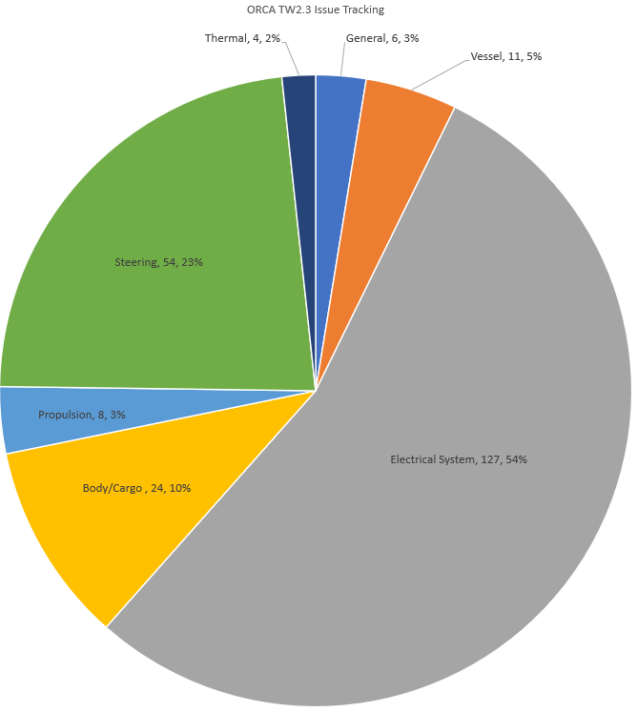
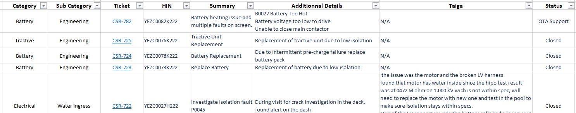
Service Issue Tracking
ORCA TW2.3
287 Craft Built
270 (+4) shipped
234 Tickets were opened (+3 => 22th of Jan 24)
7 Open items (-7 => 22th of Jan 24)
NEW ITEMS
Battery heating issue and multiple faults on screen
Ride Plate Leak
Broken center console glove box hinge point
BIG TICKET ITEMS
Water ingress
Low Isolation on battery and tractive unit

Slide 5
PERFORMANCE
PROGRAM UPDATES

Slide 6
TW03.1 Production Reworks
SCOPE
Update all the produced crafts with engineering improvements and inspecting for quality issues before sending the crafts out to customers
Validating torque of hardware
Validating correct installation of critical assemblies
Validating main seal integrity and applying liquid gasket to improve sealing
Improving water hull extraction via the jet pump
Improving water pressure supplied to the carbon seal
GOAL
Rework 408 crafts produced we have on hand before sending them out to customers
CURRENT STATUS
Reworks restarted after being on pause since the week of the 8th of January 2024
As of friday the 19th of January 2023, we reworked 180 crafts at a rythm of between 5 and 8 per day
All reworks ECOs have been approved and are now being implemented on the crafts being shipped. (Exception)
OPEN ECOs
ECO-522 – Portuguese Language Decals
Notes:
Bharath

Slide 7
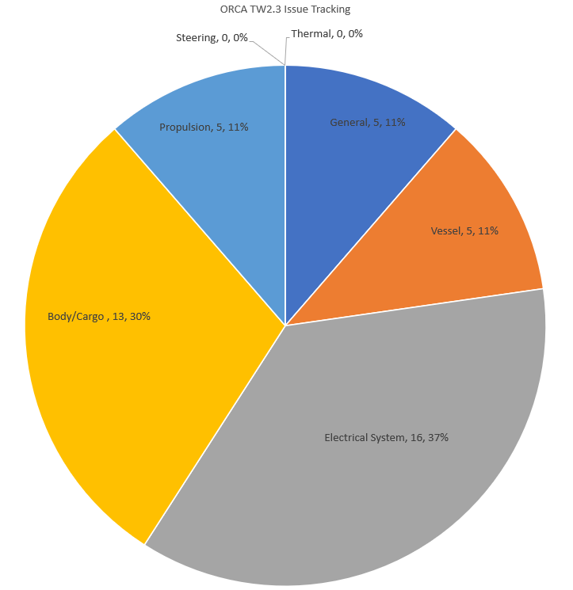
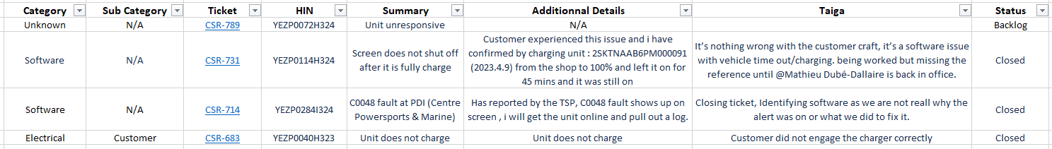
Service Issue Tracking
ORCA TW3.1
520 Craft Built
255 Craft Shipped (+6) , 197 sold to customer
44 Tickets were opened (+1 => 09th of Jan 24)
3 Open items (+1 => 09th of Jan 24)
NEW ITEMS
New unit, received unresponsive
BIG TICKET ITEMS
N/A

Slide 8
TW03.2 updates & timeline
SOP (tentative) : Sub-assy & Battery : April 22nd April 16th
Main Line : April 29th April 24th
EOP : July 31st
BOM release : March 13th
Volume : 530
Project | Design Release/Project status | Next steps | Risk Level
Hull & Deck (2 PN) | Deck first shots planned in the week of March 25th | Hull first shot timeline + PPAP for both projects, Estimated SOP ~ 2nd wk May | MEDIUM
Jet Pump rework at Supplier (Solas) | CARBON Jet pump inventory to be consumed before new PERFORMANCE. New Rev for Performance Jet pump released | PO approval for Solas + Rework all existing stock | MEDIUM
In-mold Black Color | ECO approved | Project stalled – Sybridge past due payments. | Clear Sybridge payments + Launch tool polishing, Estimated SOP ~ End May | HIGH
Resource Seat Structure | Released | Pending sample (1st week of April) + testing | Sample testing ~ 2nd wk of April, Estimated SOP ~ End June | MEDIUM
New Crate design for export in S. America | Initial concept reviewed with Millet | Project will be stalled if past due payments are not cleared | Design iteration + sample testing, Estimated SOP ~ End April | MEDIUM
New EMI/EMC brackets | Service feedback | in Design review , potential obsolescence | Review Quotes + discuss cost impact | MEDIUM

Slide 9
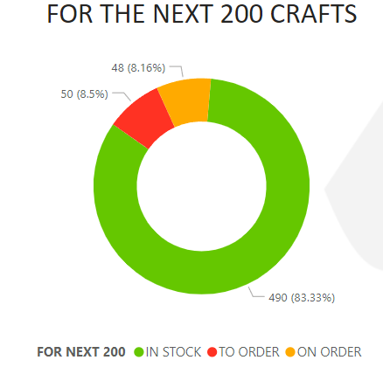
Procurement status
PROJECT | ON ORDER | TO ORDER
Vehicle | 42 | 48
Battery | 5 | 0
TU | 1 | 2
ON-GOING ACTIONS - P13111 | Inv Cover: On Going Quality issue (Mitigation is ongoing + No Risk at SOP)
- Follow up on the orders released + Awaiting a schedule confirmation from the supplier
- BULK items planning and ordering
Forecast on Configurations is yet to be disclosed to release the OTB on CONFIG parts
Finalising the LABEL commodity to ensure P2P cycle is smooth
Throttle Assemble – Procurement actions on going and a decision is pending
MBOM release for the Sub Assy(s) to map the material planning database with in-stock sub(s).
KEY COMMERCIAL ISSUES
Limited payments causing delivery risks on some commodities and suppliers asking for anticipated payments (E.g. Sybridge).
Close monitoring required on Harness, Jet Pump, Seat Support and New crate.
Sourcing to be approved on new VCU/Charger Brackets

Slide 10
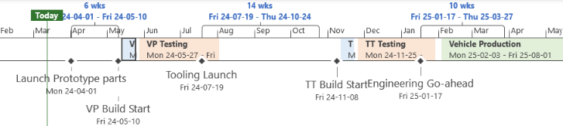
TW03.3
SCOPE :
Reduce BOM costs through VA/VE opportunities & further supplier negotiations
Introduction of ORCA 3UP
VP crafts would be TW03.1 TT crafts retrofitted with PROTO parts
Platform Projects currently under Final review

Slide 11
CONSOLIDATED PROG. UPDATE
Notes:
Bharath

Slide 12
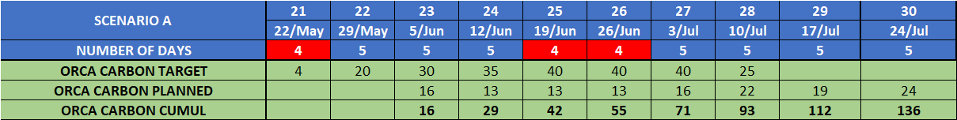
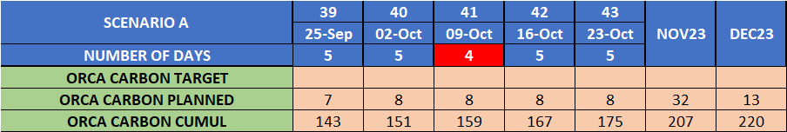
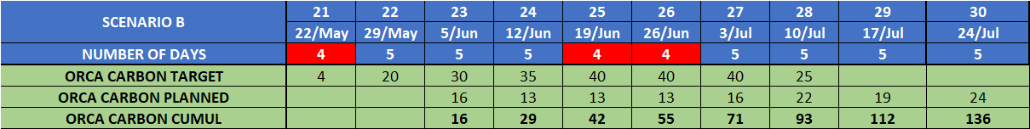
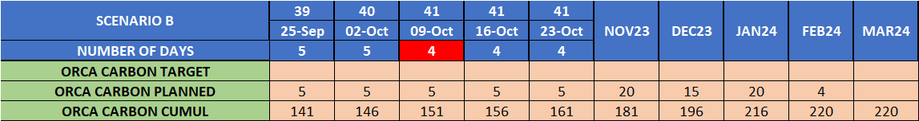
MASTER AND PRODUCTION PLAN
SCENARIO A: Build at Bay area. With a specific set of Techs, Two Shifts per day
SCENARIO B: Build at Bay area. With a specific set of Techs, One Shift per day
Notes:
Jeremy/Joan

Slide 13
VEHICLE LEVEL UPDATE
Notes:
Bharath

Slide 14
BATTERY PACK UPDATE
2023-07-25
We are yet to build 29 BPs (14 are built and awaiting rework, 15 are yet to be built), including the service requirement to cover the target of CARBON MY 2022
Notes:
Jeremy / Jasmine / Bharath

Slide 15
TRACTIVE UNIT& ELECTRONICS UPDATE
Accomplished
Notes:
Sylvester / Jeremy/Bharath

Slide 16
PURCHASING - ORCA COMMODITIES AT RISK - MP
Commodity at risk | Reason for Risk | Mitigation Plan | Tentative Date
Hull & Deck | Production from VCI Brazil limited at 10 hulls + 10 decks per week for remainign qty Quality issue on decks : 11 to be reworked (lack of raw material) | Production plan reviewed as per VCI capacity First 6 hulls machined from VCI Brazil ETA Taiga January 26th Hull for 3rd mold approval - ETA Taiga (machined) TBC | Ongoing
Casted parts | Porosity on part creating leak issue on ride plate (issue appeared since powder coating was stopped) | Coating the porosity area | Jan 27th
Screws | 50% scrap rate on screws for imperial rivnuts | Reorder rush ETA Taiga Feb 1st | Feb 1st

Slide 17
PLANNING
Item | Status | Risk /Roadblock & impact details | Mitigation / Action | Action deadline
Parts in validation | RISK | Steering Column, mounting plate and TnV are still in design and validation | Need an answer this week to not put the production at risk | 23 Sept
Quality of parts | RISK | Ride plate, New Bumper are not accepted (out of stock in 2 weeks) | New batch to come, quality to be determined upon reception | 23 Sept
TT between PP and MP | DONE | List of parts change by HIN done by Clément | Need a decision between PP50, PP75 or PP100 | 16 Sept
Scenario for Orca22 | DONE | Scenario based on arrival of parts | S&OP meeting Thursday | 15 Sept

Slide 18
VEHICLE Manufacturing and PRODUCTION
Item | Status | Risk /Roadblock & impact details | Mitigation / Action | Action deadline
Change and deviation management | Under control | MP parts need to be validated for assembly prior to formal introduction to the line | Changes planned for HIN058 = only fasteners Other changes Will be building TT MP when bulk of new parts have arrived (date TBD) | 2022-09-13
Achieving target assembly work content | Ongoing | Hard to evaluate due to lack of "clean run" without issues; need to drive emphasis on achieving standard times Need a clean dataset and target time to do rebalancing | Event tracking process to be implemented by Sept 16th Incentive on achieving std time for each app Spin test automation and simplification kicked off Test pool repaired, test parameters modified | 2022-09-30
Increasing assembly quality (right first time) | Ongoing | First pass yield below target of 70% | More formal workforce training and certification Air leak test for hulls Holistic pre-closure tests performed by quality Complete PFMEA + connect torque tools + last station checks for WHMA-02 Improve CAR standard reporting for data compiling | Ongoing
Rework management and Line Support | Ongoing | Line rework cause off-sequence assembly and mistakes, need tracking of time | Event tracking process to be implemented by Sept 16th | 2022-09-16

Slide 19
VEHICLE Manufacturing and PRODUCTION
Item | Status | Risk /Roadblock & impact details | Mitigation / Action | Action deadline
Assembly issues ending up in customer's hands | Ongoing | 20-30% of CSR requests arise from assembly mistakes | Create CSR dashboard (done) Ensure RCA done + Corr Action implemented for each issue (under way) PFMEA/Last station check under implem. | 2022-10-10
EOL pool testing non-operational | Ongoing | Pool cannot be used in wild mode, nor with rider Outside shakedowns limited by cold weather | Pool holding system redesign (50%) Remote vehicle connection (20%) Adapted test plan (30%) | 2022-11-16
TU alignment | Ongoing | Step requires highly qualified technicians, error prone and lenghty | Improved jig (80% done) IoT measure system + shim calculation Design improvement (To discuss with engineering) Plan for safe use of TU station spin test In-line spin test planned for Jan 2023 | Ongoing
Reaching 4 veh/day uninterrupted cadence | Ongoing | Assembly issues/rework Missing parts Performance management | Station target-setting + gamification RCA for all assy issues in line + last station check Part fulfilling operations deep-dive + trial | Ongoing

Slide 20
Powertrain production and Automation
Item | Status | Risk /Roadblock & impact details | Mitigation / Action | Action deadline
Module Stacking Line Throughput | On track | Reducing real cycle time to reach production targets Target: 4min/module | Improve robustness Fine tuning of stacking process Currently 5min/module Barcode scanning slows down the process, waiting for printers | 2022-09-30
Assembly process & time tracking | On track | Bugs in new design are present | Core functionality established and tested Reporting solution in process | 2022-09-30
Ultrasonic welder offline | Production blocking | ABB robotic controller has apparent chip failure Module welding cell is offline | In contact with ABB to troubleshoot and resolve ABB technician will come in to replace board | 2022-09-16
New module seal design | On track | Seals fall out of cartridges easily, increasing isolation risk Cannot kit in advance as seals jump out over time | Process adjustments reduced failure rate Waiting for updated seals from battery team | 2022-09-23

Slide 21
Quality
Item | Status | Risk /Roadblock & impact details | Mitigation / Action | Action deadline
Decks Brazil machining | RISK | Deck Machining not working as planned Supplier expereincing difficulties with parts et-up and variation to CAD Line stoppage | On-site support as required (David m + Operations Tech) Thanks to operations ! Decks readiness estimated 11/23 late Logisitic support requested
Hulls Brazil at Laval Tool | OPEN | VCI Brazil awaiting our decision for Hull production | Lack of time to focus on hull | 11/24
Rubber boot | OPEN | Being investigated for durometer issues with Eng. | TBD | 11/23
Leaking fittings Ride plates | OPEN | Patched with silicone. discussion with Eng. to happen today to validate. | TBD | 11/24

Slide 22
Service calls Process *proposed*
Service team
Receives customer concern
Planning
Program team gets notified
Defines accountability for warranty repair
RCA and corrective actions
Respective departments
Supports RCA and prepares data
Parts are requested as MINGLE request
shares action plan for concerns

Slide 23
Durability and Shakedown strategy update
Item | Responsible | Location | Scope | Frequency
VP & TT units | Performance Team | River | VP – 100% extensive shakedown on water TT – 100% extensive shakedown on water 25 hours per craft, represents 1 year of usage (50 hours i.e 2 years of usage), reset testing hours onset of systems failure | 100% 100%
First 10 PP or until we reach 10 consecutive pass results | Performance Team | River | In River – Standard shakedown to validate functionality of PWC (40min) River water cleaning to validate (BBouffard) | 100%
If above satisfactory PP11 and beyond | Production to transport PWC to Dollard and set up Quality to shakedown in Dollard pool | Dollard | Truck to secure (MBattault) PWC would be rolled and secure in and out of truck at docks Performance team to train 2-3 Quality workers to test Dollard pool safety to be validated and strict operating rules enforced | 100%
If above satisfactory PP11 and beyond | Performance Team | River | Standard shakedown to validate functionality of PWC Deep water cleaning to validate (BBouffard) | 1/50 PWC
MP | Production and Quality team | Lafleur | Standard shakedown to validate functionality of PWC | 25-100% based on performance
The scope of the shakedown is to validate proper Assembly of units at PP, their functionality as per standards, and that no special cause occurred. (like gross leaks, Isolation issues, no steering for example)
It is not intended to be a durability test. VP and TT units should validate product durability and performance.

Slide 24
Test Fleet Status
CRAFT/HIN # | Current condition | Total Recorded Hours | Hours after last break down
VP01 | New Battery trial testing | 36
VP03 | New Battery trial testing |  | 9.2
VP04 | Drop test craft
TT01 | EMC/EMI testing | 47
TT02 | Low Isolation codes - Need RCA | May be required for OTS testing | 40
PP01 | HIN 7 | Low Isolation and coolant leak | 33
PP02 | HIN 8 | Driveshaft needs replacement + Motor alignment | 42
PP04 | HIN 10 | Driveshaft needs replacement + Motor alignment | 22

Slide 25
Program Group status

Slide 26
Test and valiDation
Item | Status | Risk /Roadblock & impact details | Mitigation / Action | Action deadline
Electromagnetic Compatibility Testing | On going | RISK : compliance to market Official Verification at risk | Engineering Testing @Nemko on Sept.23rd Official verification planned week of Sept. 26-30 | Full Scale solution SEP2022
Battery Heat Ramp Up | HOLD | Awaiting DUT, lab scheduled
Ingress Protection (IPX7) Battery | Done
Steering Impact | WIP |  |  | Next in line
Vibration Battery Stack Ref. 38.3 | WIP |  |  | Sept 16th
Rotational Speed limits | WIP | Risk: delay in testing Manufactuturability of a adaptor shaft | Manufacturing outside (outsource) | Oct 1th
Dash Ingress Protection | HOLD | Dash need to be rework prior testing
OTS | Complete |  | ACTION: Data to compile ACTION: test report to complete | Sept 23rd
Moring Hook test | Awaiting quote

Slide 27
hardware
Item | Status | Risk /Roadblock & impact details | Mitigation / Action | Action deadline
Next level assemblies from Suppliers | On Track | Labour Risk Electronic assemblies can be assembled into the next level assembly (mechanical, potting, etc.). Estimates for costs and lead times still to be determined. | Complete designs and drawings. Dash expected to be done at Lafleur. Tether Key moved to supplier. | May 01 May 17 May 31 June 20th
General - Reliability Testing | ON HOLD | Technical Risk Reliability testing is on-going and has not found any critical areas yet. Safety Case Will not be able to put create any documentation for this year. | Working with Battery Team to perform DMFEA for battery electronics. Will work with Systems team to perform further analysis for next year. | June 30th
MP Assemblies | On Track | No issues Slightly ahead of production schedule for August and early September. | CMs will be able to supply all except the Dash full assembly in the next 2-3 weeks. | July 25
New Markets Introduction | ON HOLD | CE and Australia are noted as new markets Require specific requirements and standards to meet to sell in these markets. | Vehicle Team to communicate specific standards and requirements for each country or territory

Slide 28
tractive
Item | Status | Risk /Roadblock & impact details | Mitigation / Action | Action deadline
Castings corrosion resistance | On Track | Redstone castings exhibit excessive corrosion | Passed leak test with tractive unit from corrosion test. See low risk to the functional issues from corrosion, just aesthetic. Most likely scenario for current orca is to leave parts as is. Working on a long term solution. PP/MP will not have additional corrosion protection | July 22
Motor leak in flooded craft | Closed | Two craft came back to eng team after being flooded for multiple hours/days. Both motors have water ingress in the inverter, but one much more limited than the other | RCA in progress New tractive units tested and passed IP68 rating (overnight in pool without ingress) Leak reproduced on customer TU that leaked. Investigating if piece variation, change over time, or other factor is impacting leak Defining an air leak rate to correlate to ingress protection Root cause identified as cable gland tightening procedure. Fix is validated and the process change has been implemented on the line. Existing TU stock has been checked and all glands re-tightened as necessary. | Sept 9
2023 Gate 1 | On Track | Working towards release of Orca 2023 XBOM, and finalization of sourcing plan | Completing review of any changes for Gen5.2 TU. Review with manufacturing team this week.
2023 Gen5.2 Gate 3 | Open | Close gate 3 for part freeze and tooling design | Gate 3 checklist by Oct. 14, Gate 3 closing date the following week. Casting and motor stamping tooling already kicked off to contain lead time | Oct. 21

Slide 29
Thermal
Item | Status | Risk /Roadblock & impact details | Mitigation / Action | Action deadline
Thermal derate management | On Track | Vehicle quickly hits thermal limit at high power | EIS module level derate implemented as part of firmware V2022.31.0.0 (released 12-08-22). Implements coarse protection of TU and BATT All new vehicles update is done at EOL. Previously sold customer vehicle not yet updated. Vehicle level derate to be implemented to smooth de-rate "feel" for user; end of Sept 2022 (pending module data availability). Derate algorithm updates can all be pushed via OTA updates once available | Aug 8
Gate 4 & 5 Checklist | On Track | Not all documentation for Gate 4&5 complete | DVPR complete, PFMEA and control plan captured in vehicle | July 29
2023 Gate 3 Checklist | On Track | Working towards release of TMS architecture and rideplate re-design Plan is to release thermal at gate 3 with any changes marked with ECO | Awaiting battery layout decision Working on system model to define if any rideplate changes Layout to stay the same until further notice Need CAD and engineering release resource

Slide 30
Battery
Item | Status | Risk /Roadblock & impact details | Mitigation / Action | Update | Action deadline
Enclosure Frame | On Track | Variation in casting parts thickness resulting in not enough thread engage in the bolt joints | Evaluate if enough thread engagement and no loosening issue possible | Testing on a vibration table tin progress no failure as for now . A pack will also be used on a TT unit for validation Machining operation at supplier to correct the thickness implemented | Nov.4th
Cooling Panel | On track /At risk | Coolant leak because cooling panel delamination | New pouch material | Die installation this week Material testing in progress, new pouch from supplier received | Nov.14th
Gate 2 | On track/At Risk | Budget definition Scope of changes | RFQ evaluation Improvement list based on lessons learn | DFMEA/DVP&R in progress CAD/DFA preliminary in progress QA requirements definition in progress | Nov.4th

Slide 31
SOFTWARE
Gate / Milestone | ECD | Status | Tasks, Risks & Roadblocks | Mitigation / Actions required
OTA Update Robustness (Embedded + Cloud) | 2022-09-28* | ON TRACK | Implement user confirmation Add more progress cues to the user Grounding the vehicle during update is at risk for the next release | Integration and validation in progress Partial release without the vehicle grounding
Under the hood vehicle software (Embedded + Firmware) | TBD | ON TRACK | Working on VBIFR top issues Continue on the charger issue RCA Power distribution Short-circuit protection (in progress – 80% done) High Speed log to be completed today Improved GPS (rate and lat/long accuracy) has been released already in the backend, missing the UI part to show GPS speed instead of estimated speed to the user | Team bandwidth
Mobile App Internal Launch | 2022-09-14* | ON TRACK | Release of Bluetooth and Wi-Fi management features on the vehicle to be included in this week release. App approved on the Apple App Store ☺ Pending approval from Google… | Internal testing to be widen to more users, including marketing for instance Will include some selected customers as beta users to help in the validation
Trim Actuator Firmware update | 2022-09-14 | DONE | Validation & Implementation of the shorter stroke length of the Actuator Needs to be validated before final release | Firmware set to be released on September 14th

Slide 32
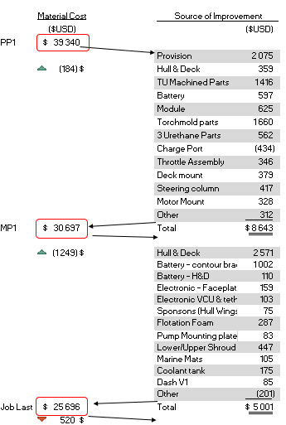
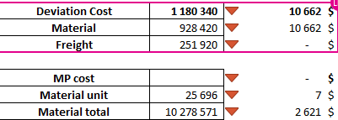
FINANCE KPI
Deviation KPI
Material cost KPI

Slide 33
Finance
Item | Status | Risk /Roadblock & impact details | Mitigation / Action | Action deadline
Gate 4 finance | Done | Next update next week | Material : 25 696$
22 OPEX and CAPEX review | On target | No roadblock expected |  | Friday Sept 23
Orca 23 major saving | Open at Risk | SMC hull and deck // PO sent Battery pack | Need to confirm the official timeline for SMC CRITICAL RELEASE OF DRAWING SEPT 30 with battery and 2.5 up | Waiting Gate 0

Slide 34
Finance
Item | Status | Risk /Roadblock & impact details | Mitigation / Action | Action deadline
Gate 4 finance | Done | Next update next week | Material : 26 964$
Orca 23 major saving | Open at Risk | SMC hull and deck // PO sent Battery pack | Need to confirm the official timeline for SMC CRITICAL RELEASE OF DRAWING SEPT 30 with battery and 2.5 up | Waiting Gate 0
Orca 23 volume plan | Open at Risk | Need to establish a 3-year plan with Orca and Snow that we can communicate consistently | Waiting Gate 0 | Waiting Gate 0
Orca 23 Budget target | Open at Risk | Need to confirm the Budget target per system | Financial model target done, Waiting Gate 0 | Waiting Gate 0

Slide 35
Sales ops
Item | Status | Risk /Roadblock & impact details | Mitigation / Action | Action deadline
Florida Configurations | OPEN | Configuration needed for panel and seat color | Florida calls have started with a 20% conversion rate. Offering sales levers to QC and On config units who did not yet take delivery and the season is ending | ASAP
Go to Market | OPEN | Cross functional team working through go to market challenges and pivoting timelines | G2M strategies for Key US State presented by legal 9/13 | ASAP
Paperwork | OPEN | ERP automation Delivery packet | Working with IT for automation timelines Created docs testing in Prod environment. | EOQ 3
TSPs | OPEN | BC, AB California, Texas Vermont | Shortlisting Partners in Key regions. Mix of Cold calls and website applicants Onboarding process | EOQ 3
Orca Carbon Deliveries | OPEN | Delivery Hold Customer availability Delivered through TSPs | Managing customer escalations and expectations. Planning TSP training and finalizing documentation Delivering by TSP region | On Going

Slide 36
2023 MODEL YEAR
PROGRAM UPDATES

Slide 37
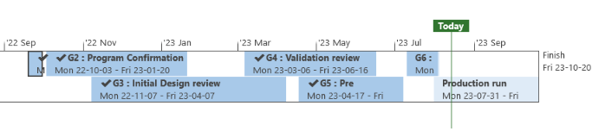
Timeline Updates
Updates :
Decks (5 units) received on 31st July, 20 additional received 1st August
Hulls (3 units) received on 1st August, next lot pick-up today (qty. to be confirmed)
Target for the week – 4 (Marketing units) by Thursday EOD, 3rd August

Slide 38
Vehicle & bench testing status
Vehicle TT01: Engineering test – 19 hours completed (Abuse tests at the start+ Certification test + Eng test) (4 hours in the last week)
Vehicle TT02: Engineering test – No running hours - EMI investigation
Vehicle TT03: Durability test – 10 hours completed (4 hours in the last week)
System | Issue | Root cause | Solution | Implementation
Sponsons | Extreme riding caused an issue where the sponsons were pulled out and cracked the hulls. | Extreme unevaluated load case | We are adding a reinforcing plate around all the all sponson holes inside the hull. | Validation week of the 7th of August. MP immediately after.

Slide 39
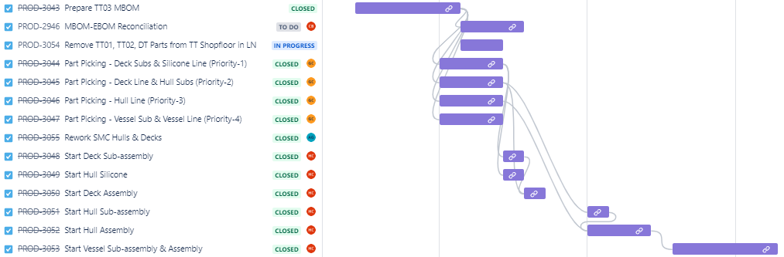
TT03 Build – Completed
Planned Start Date : 6th July 2023 Planned Finish Date : 14 June
Where we’re at:
Vessel Assembly in-progress.
Actual finish date: 19 July 2023.
Battery availability, retrofitting of deck parts & TTI Spin Test Issues lead to schedule slip.
Build completed without Bumpers and Crating Test.
Notes:
Harjinder / Marc roche / Julien

Slide 40
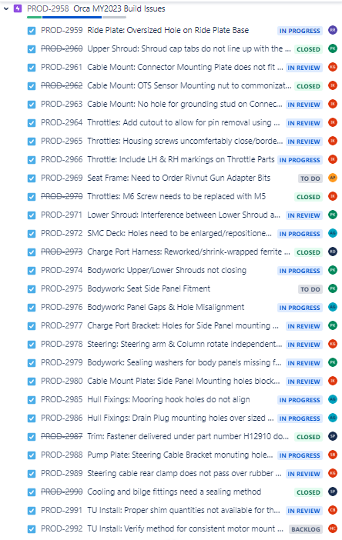
TT01 & TT02 Issues being actively addressed
66 issues identified. 36/66 Issues Closed.
22/66 Issues In review.
08/66 Issues To-Do.
High Risk Item:
SMC Hull/Deck Machining – Launching into production unvalidated machining program.
Bumper & Shroud Fitment – Updated parts on-the way for TT03.
Unreleased Parts & ECOs for Production.
Long Bolts for Securing Corner Bumpers - Unvalidated.
Steering Harness-Charger Bracket Ground – Unvalidated.
Battery Ground Joint Simplification - Validated.
HV Cable Routing ECO –Validated.
Notes:
Harjinder / Marc roche / Julien

Slide 41
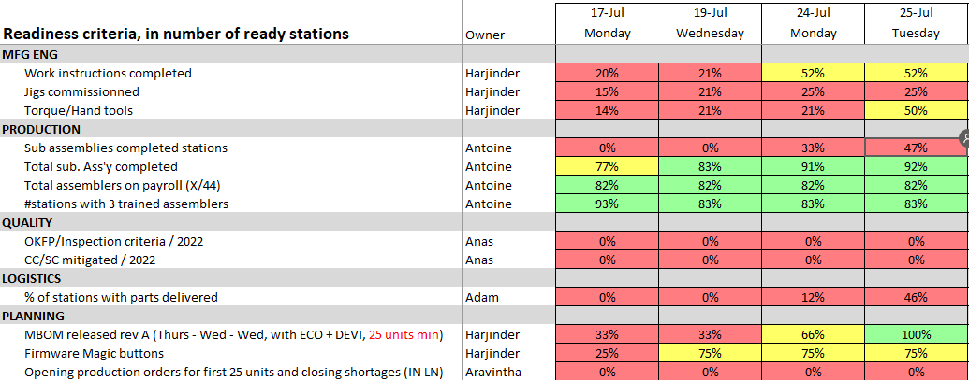
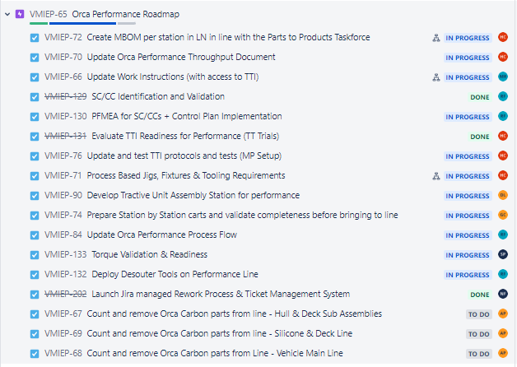
Line readiness being actively worked on
Where we’re at:
MP MBOM Released
Part picking started – 46% Parts Picked
Logistics and part swap plan in place to convert from Carbon to Performance.
WI’s in progress – 52% Complete.
All TTI program to validated.
SC-CC identification complete for PFMEAs and control plans.
Action groups created with daily meetings to train assemblers, team leads QC inspectors on upcoming changes and progress.
Notes:
Harjinder / Marc roche / Julien

Slide 42
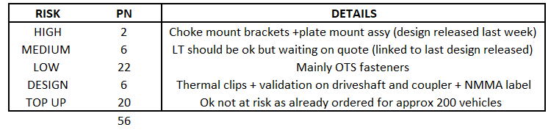
Kpi
Sourcing status :
40 new parts added to BOM following TT01 & TT02 build
11 parts remaining to order for SOP (including 6 under design)
56 parts remaining to order for full MP coverage :
On order :
30 parts at risk vs SOP date of July 30th (airfreight or machined parts will be sued as backup plan)
Notes:
Olivier

Slide 43
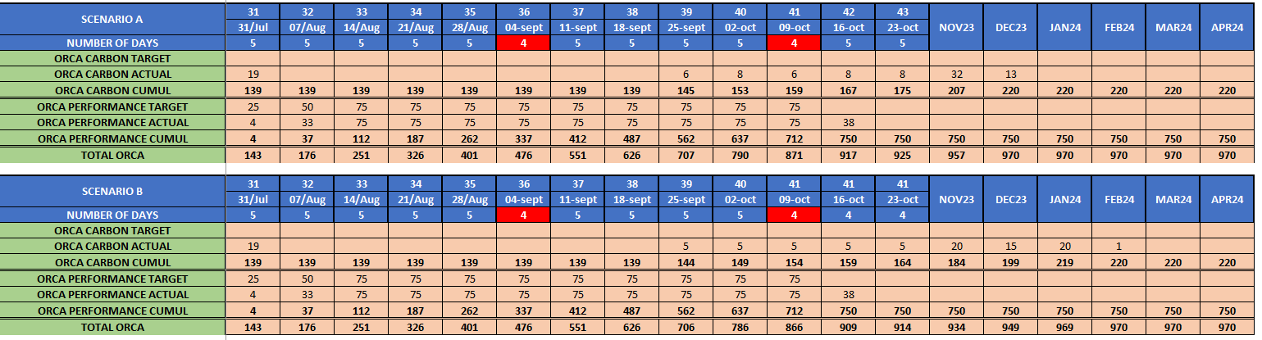
MASTER AND PRODUCTION PLAN
Notes:
Jeremy/Joan

Slide 44
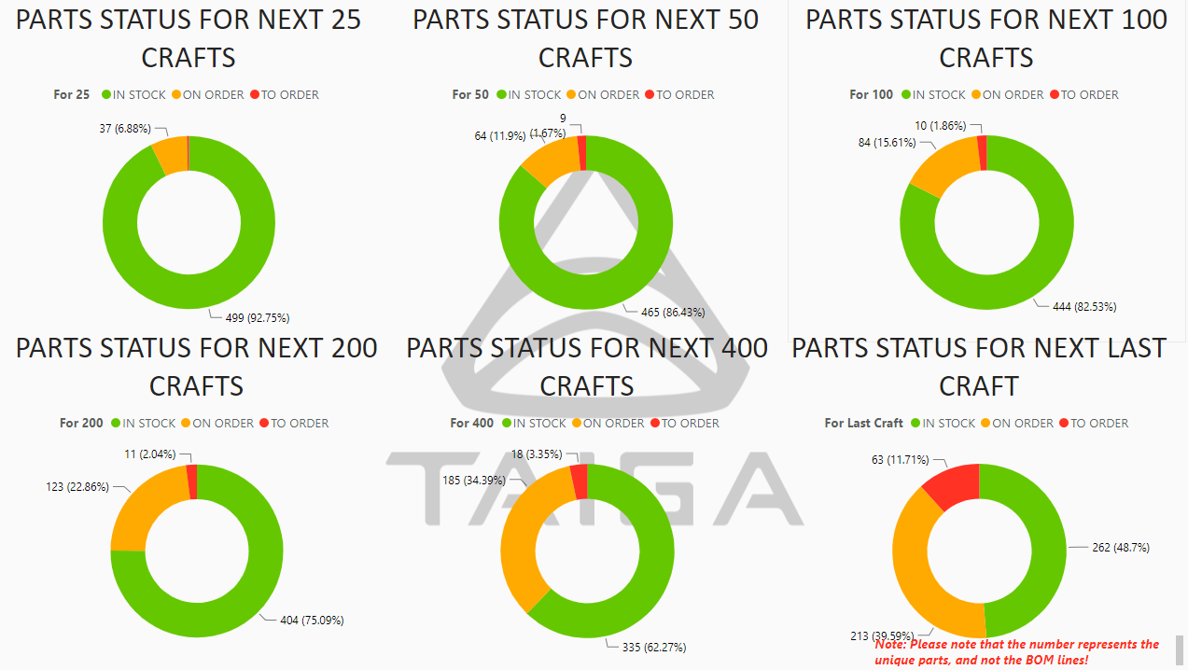
CONSOLIDATED PROG. UPDATE
Notes:
Bharath

Slide 45
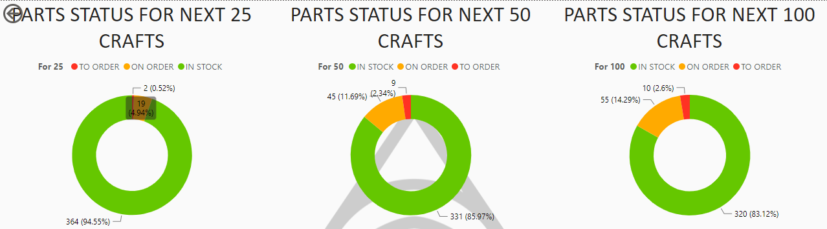
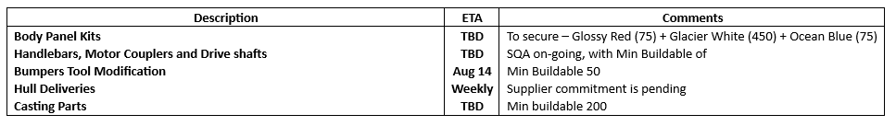
VEHICLE LEVEL UPDATE
Notes:
Bharath

Slide 46
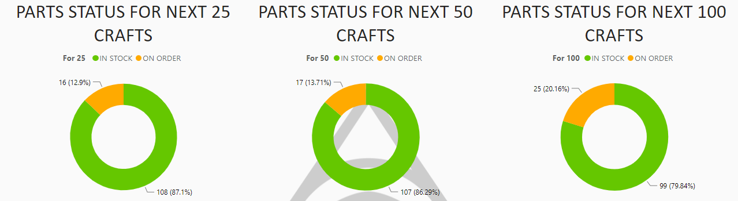
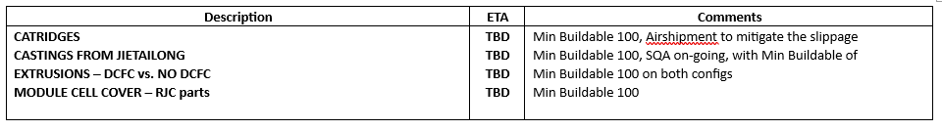
BATTERY PACK UPDATE
Notes:
Jeremy / Jasmine / Bharath

Slide 47
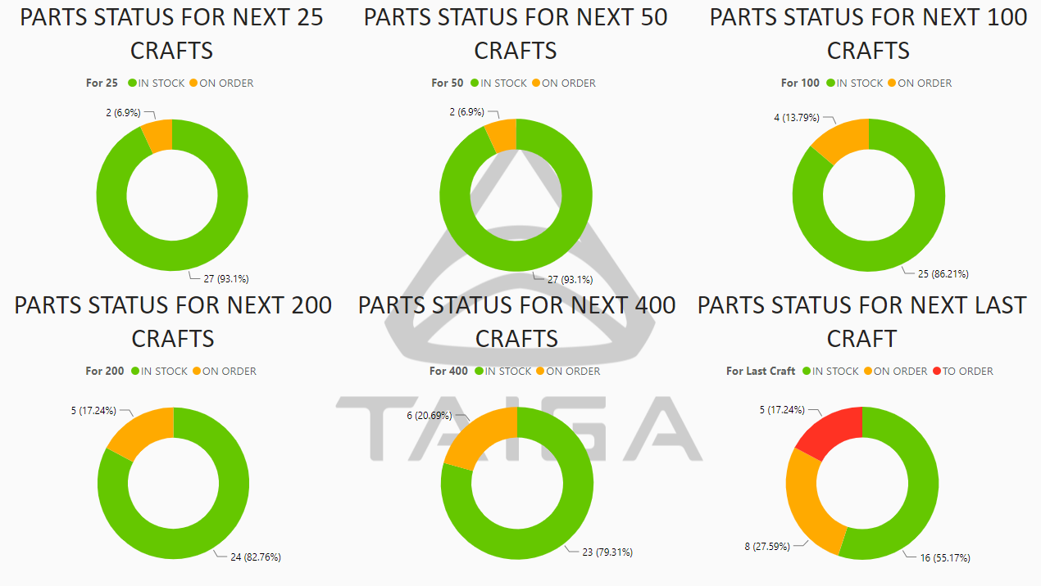
TRACTIVE UNIT& ELECTRONICS UPDATE
Notes:
Sylvester / Jeremy/Bharath

Slide 48
VEHICLE - my2023
Major highlights
Risks/Mitigation
30% design not released yet (mainly fasteners)
EMI Filter new design to be finalized to get harnesses released
Machined parts to cover casted risks for TT (25Kusd estimated impact)
Airfreight flotation foams for TT (15Kusd estimated impact)

Slide 49
Battery - my2023
Major highlights
Module:
Welding test on MD05 shows good results, ok to start production with monitoring
ITC, Cover in transit (Still not delivered and is blocking module production)
Rear endplates in transit (100 packs worth of parts, to be received today)
Frame:
Castings: 14 sets in stock (CNC + castings) + 17 CNC in transit + 68 castings in transit (Total 99 sets)
Extrusion: 48 sets in transit + more shipped on July 31st (QTY 75)
Others: Doublers RJC to be received today (Last operation)
Risks/Mitigation
Casting: Uses first castings parts with porosity
Cross brace: Start production as-is and continue the failure investigation to confirm if really an issue
Notes:
Pier luc

Slide 50
Tractive unit - my2023
Major highlights
Motor Shipments:
75 by boat (2nd batch) - Arrived at Vancouver
109 by boat (4th batch) - ETA Aug 21 (through USA)
89 by boat (5th batch) - departing (through USA)
Fukuta production
Average production rate of 90 – 100 per week. Want to increase to avoid further air shipment, but doing okay
All other parts in stock
Cable gland with production cable not passing leak test -> solution found. Adding o-ring to cable gland. McMaster part, ECO in final approval. Part/BOM updated in LN. Cost of $0.14 per motor
Risks/Mitigation
Gamma seal rubbing in craft – from measurement the axial shaft movement is too great to use gamma seal (due to carbon seal preload). Derogation in progress to allow removal of gamma seal depending on issue
Notes:
Cyrille

Slide 51
Electronics - my2023
Major highlights
MY2023 EMI solution
Orca Performance is getting the same solution used for Orca Carbon.
Hardware:
All parts available for production.
Risks/Mitigation
Fast charge bug:
A solution has been identified, an ECO to be presented soon.
Notes:
John / Raul

Slide 52
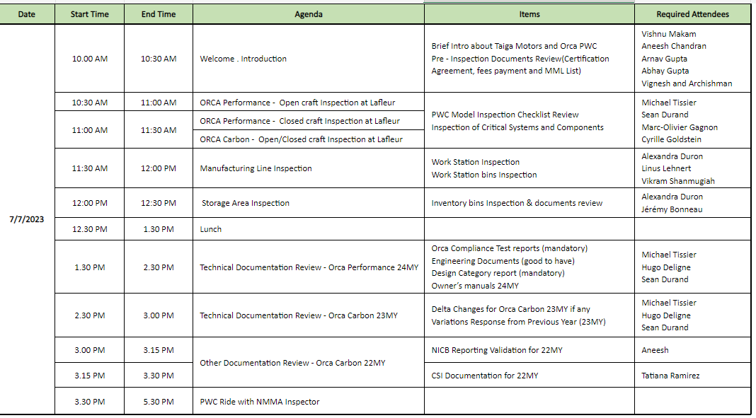
Nmma audit – 2024 performance and 2023 carbon
Notes:
John / Raul

Slide 53
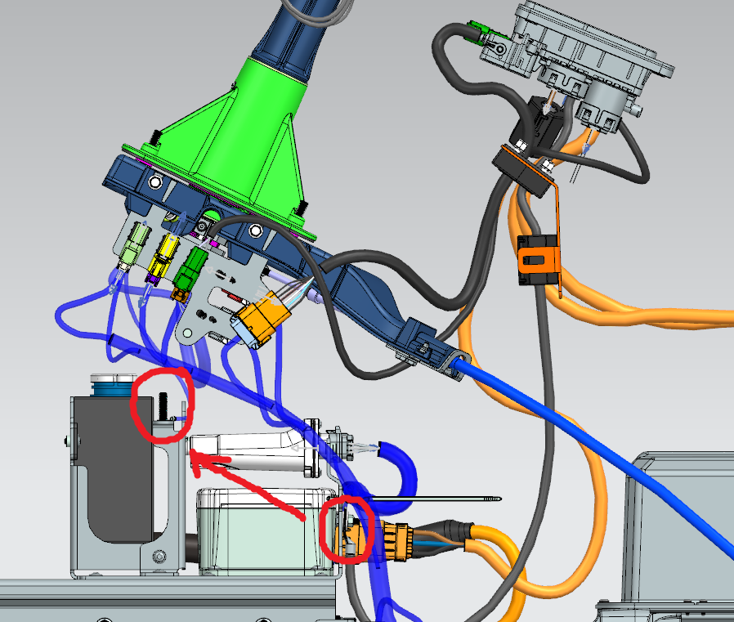
Systems and Software
Major highlights
Orca performance software changes – released as part of 2023.3.8
Remaining items are for “production line” improvement for reliability, do not pace start of production
DCFC communication issues resolved with ORCA Performance; minor impact on EMI performance for conducted emissions. ECO-350 - moving ground location.
Risks/Mitigation
EOL test station being introduced to validate vehicles equipped with DCFC are correctly enabled/functioning
Intended to detect Mismatch of hardware (non DCFC pack, incorrect BDY, software incorrectly configured, VIN/HIN mismatch with config, etc.)
Charge station to be installed (already onsite/was in inventory – coordinated with M. Roche to install at ‘sanity test’ vehicle test station)
TTI requirements to be updated at sanity test; vehicle to identify (by VIN) if DCFC to be enabled/disabled
Requires VIN reference for DCFC config to be up to date/valid when vehicle reaches EOL station
Tech will be prompted to install correct charge handle (AC or DCFC); TTI will automatically verify pass/fail of DCFC communication and charging based on VIN
Notes:
Vehicle level TMS validation on going
Minor deltas at component level; confirmation at vehicle level impact pending cast ride plate availability. Not identified as significant thus far
EMI/EMC status
TT2 was tested for north American compliance; deltas identified in radiated emissions between carbon/performance, under investigation.
OTS (off throttle steering) – test plan aligned with performance; firmware changes for testing queued and ready for test/post processing of results.

Slide 54
Production targets
PWC_MY23_Production Schedule DRAFT.xlsx (sharepoint.com)

Slide 55
G2 Updates
 | G2 | Status
 | Program Confirmation
Gate Requirement Summary | Program requirements, timelines, resources are fully defined and achievable for vehicle launch targets
Program Management | Program project milestones and gate release definitions confirmed across all functional areas | Done
Engineering | -System requirements confirmed -eBOM structure complete - Industrial design shape release | - In Review - Completed - In Review
Supply Chain | -Supplier or supplier development plan identified -Cost & Leadtime estimate for each commodity from RFQ or historical data | In Review
Manufacturing | -Manufacturing Feasibility Proven - Required Operational changes identified - Time & capital costs estimated | In Review
Finance | - Cost targets defined -Program budget defined | In Review
Compliance | -Market compliance requirements identified | In Review
Sales | -Forecast volume & price -Market launch strategy | In Progress
Marketing | -Engineering requirements meet customer reqs -Marketing product launch timing & strategy | - Completed - In Review
Gate release documents | -Product Design Specifications & Requirements -xBOM & structured eBOM -Commodity-level Gate deadlines until launch | In Review

Slide 56
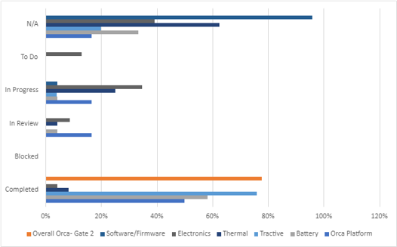
G2 Updates
Open Item​ | Name​ | Target Date​ | Actual Date​ | Status​ | Comment​
Vehicle and System Level DFMEA Completed​ | Platform Engineering​ | 20-Jan | ​ | In Progress​ | ​
Design Verification Plan - Vehicle and System Level Defined​ | Platform Engineering​ | 20-Jan | ​ | In Progress​ | ​
Vehicle System Level Weight targets defined​ | Platform Engineering​ | 22-Dec | ​ | In Review​ | ​

Slide 57
Finance – bom cost target vs Projection
Budget Target | 14,409.00 $
Budget Variance | 304,27 $
Current Budget | 14,713.27 $
Actual Variance | 120,00 $
Current Projection | 14 833.27 $
Total Variance | 424,27 $
Current projection :
+120$ jet pump as per nego with Solas
Fukuta nego complete and achieve target
Current Timeline Finance Gate 2 :
Gate 2 finance Approval : Schedule November 7th | [Done]
Gate 2 finance final correction : Schedule November 28th

Slide 58
Engineering
Open Item | Name | Target Date | Actual Date | Status
System level CAD with defined boundaries (50%+ completion) | Platform Engineering | 23-Nov |  | In Review
RFQ geometry provided for long-lead NPI | Platform Engineering | 18-Nov |  | In Review
Vehicle and System Level DFMEA Completed | Platform Engineering / Program | 18-Nov |  | In Review
Vehicle System Level Weight targets defined | Platform Engineering | 18-Nov |  | In Review
Functional requirements defined for all systems, software and subassemblies (See System Requirements Template) | Platform Engineering / Program | 18-Nov |  | In Review
Boundary Diagram, Interface Matrix, Function Tree | Platform Engineering | 18-Nov |  | In Review
Certification & Markings requirements | Platform Engineering / Program | 18-Nov |  | In Review
RCC Documentation completed | Platform Engineering/ Program | 18-Nov |  | In Review
Create safety case | Platform Engineering/ Program | 18-Nov |  | In Review
Packaging study first pass | Platform Engineering | 18-Nov |  | In Review
Industrial design 3D release | Industrial Engineering | 18-Nov |  | In Review

